Slide 1
ML.NET & .NET Core
For practical and production use of artificial intelligence
Václav Novotný

Slide 2
About me
You know, I am something of a scientist myself
Software developer
Cybernetics & Automation - VUT, FEKT
Enthusiastic about Computer Vision and Artificial Intelligence in general

Slide 3
What to expect
About ML.NET
ML.NET Pipeline
Demo #1, Demo #2, Demo #3
Deep learning and Demo #4
Devtips

Slide 4
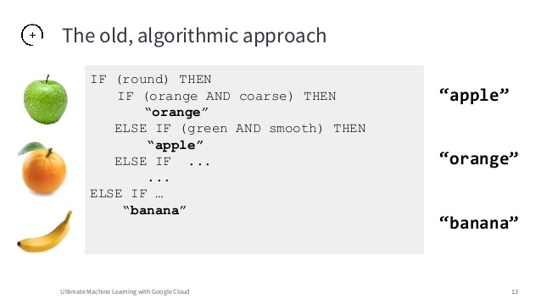
The Goal of machine learning
PROGRAMMING THE UNPROGRAMMABLE

Slide 5

What is ML.NET
Its machine learning for .net, obviously
Open-source
Create and consume custom models
Import and use pre-trained Tensorflow and ONNX models
Online and offline scenarios
Including Azure Functions
Runs on Windows, Linux and macOS using .NET Core

Slide 6
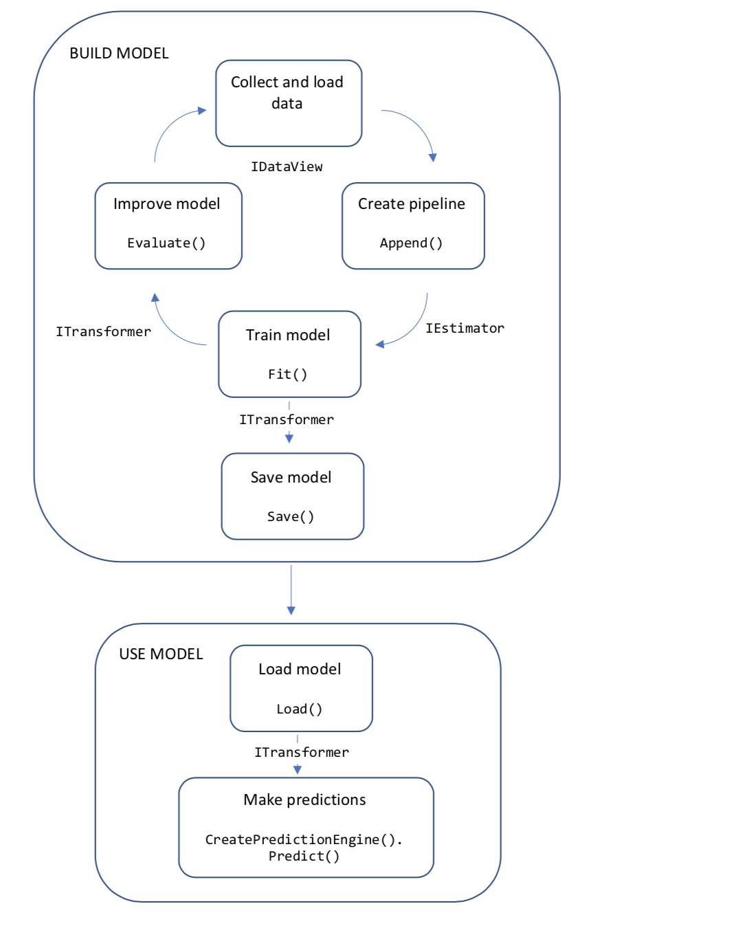
Code workflow
IDataView
IEstimator
ITransformer

Slide 7
ML.NET Pipeline
Raw
data

Slide 8
ML.NET Pipeline
Raw
data
Prepare data

Slide 9
ML.NET Pipeline
Raw
data
Prepare data
Train model

Slide 10
ML.NET Pipeline
Raw
data
Prepare data
Train model
Evaluate model

Slide 11
ML.NET Pipeline
Raw
data
Prepare data
Train model
Evaluate model
Consume

Slide 12
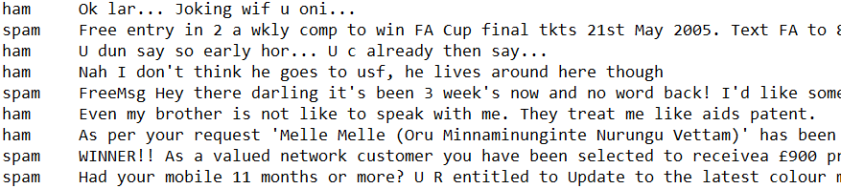
What are raw data?
Raw data

Slide 13
Data preparation
Column operations,
Normalizations,
Data conversions,
Text/image transformations,
Feature selections,
Missing value operations,
…
Prepare data

Slide 14
What can you train?
unSupervised learning
Clustering
Supervised learning
Binary/Multiclass classification
Including deep learning
Regression
Anomaly detection
Ranking
Recommendation
Train model

Slide 15
Metrics, metrics, metrics
For enthusiasts
For developers
https://docs.microsoft.com/en-us/dotnet/machine-learning/resources/metrics
Binary/Multiclass classification metrics
Accuracy, AUC, AUCPR, F1
Micro/Macro accuracy, Log-loss, Log-loss reduction
Regression metrics
R-squared, Absolute-loss, Squared-loss, RMS-loss
Confusion matrix
Evaluate model

Slide 16
Consume it!
Trained models can be stored to ZIP files, or saved as byte array to database
PredictionEngine
Data.CreateEnumerable<>
Consume

Slide 17
Spam detector
Demo

Slide 18
ML.NET Pipeline
Where everything is „manual“
Raw data
Evaluate model
Consume
Prepare data
Train model

Slide 19
AUTOML
Automatization in ML.NET
Raw data
Evaluate model
Consume
Prepare data
Train model

Slide 20
AUTOML
Demo

Slide 21
End-to-end automl
demo

Slide 22
More automl
Command line

Slide 23
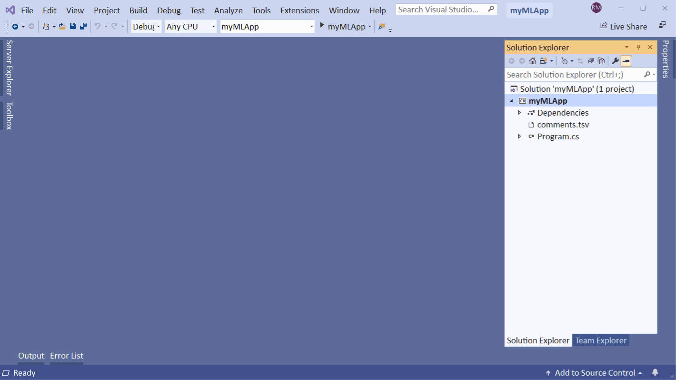
More automl
Model Builder

Slide 24
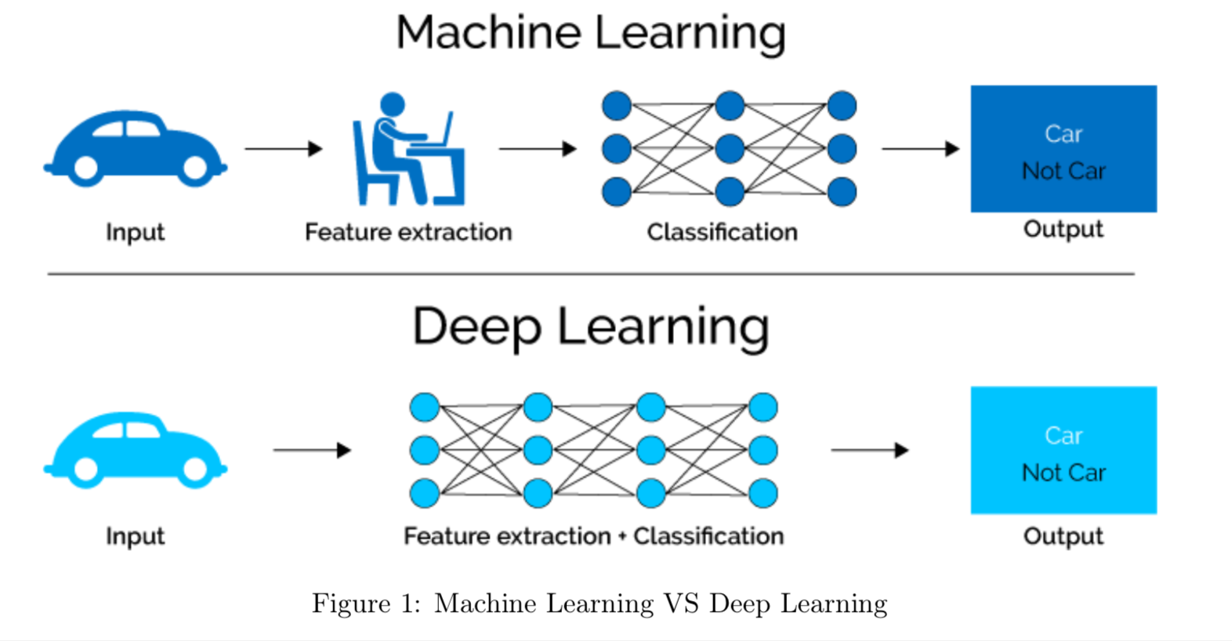
Deep learning in ML.nET
Extracting features manually? Ugh!
Since ML.NET >=1.4
Support for ONNX models
Integration of Tensorflow.NET
Support for GPU acceleration
ML vs Deep learning

Slide 25
Dnn Image classification
DEMO

Slide 26
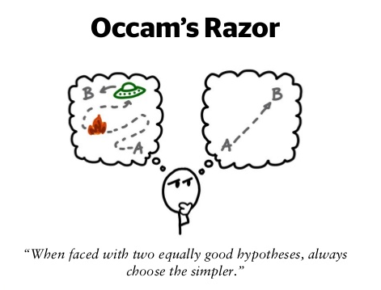
Final devtips
Occam‘s razor
Normalize your data
Balance your datasets
Strong classifier principle

Slide 27
RQA
Video

Slide 28






Want to be part of rqa team? Join us!

Slide 29
Q&A

